Slide 1

Your happiness is our first priority :-(
Notes:
Emma

Slide 2
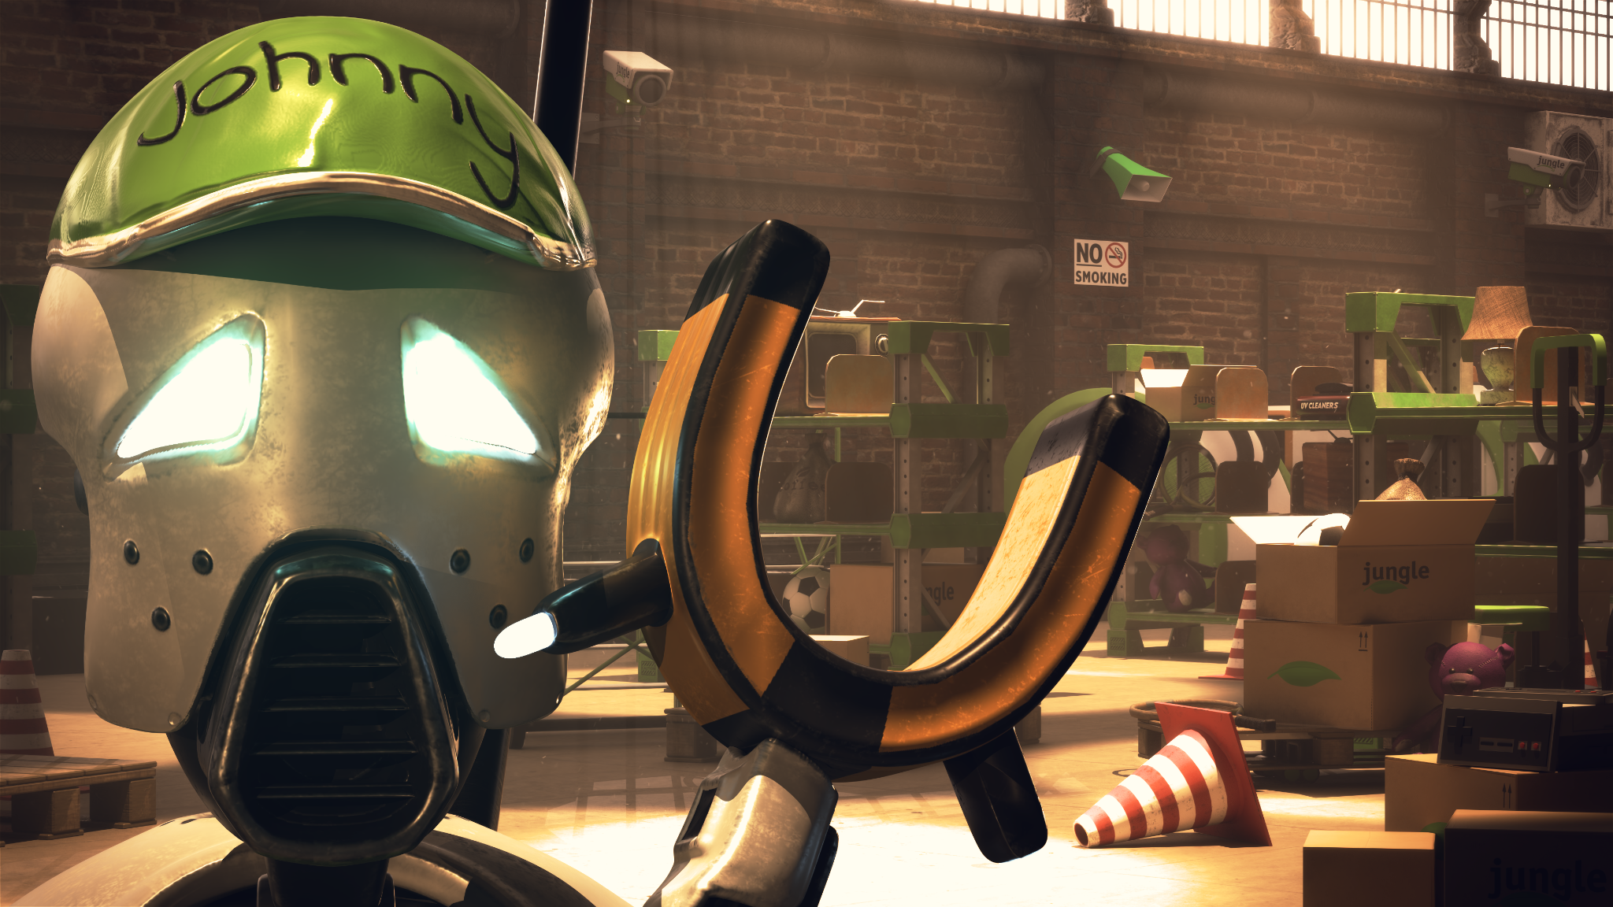

Slide 3
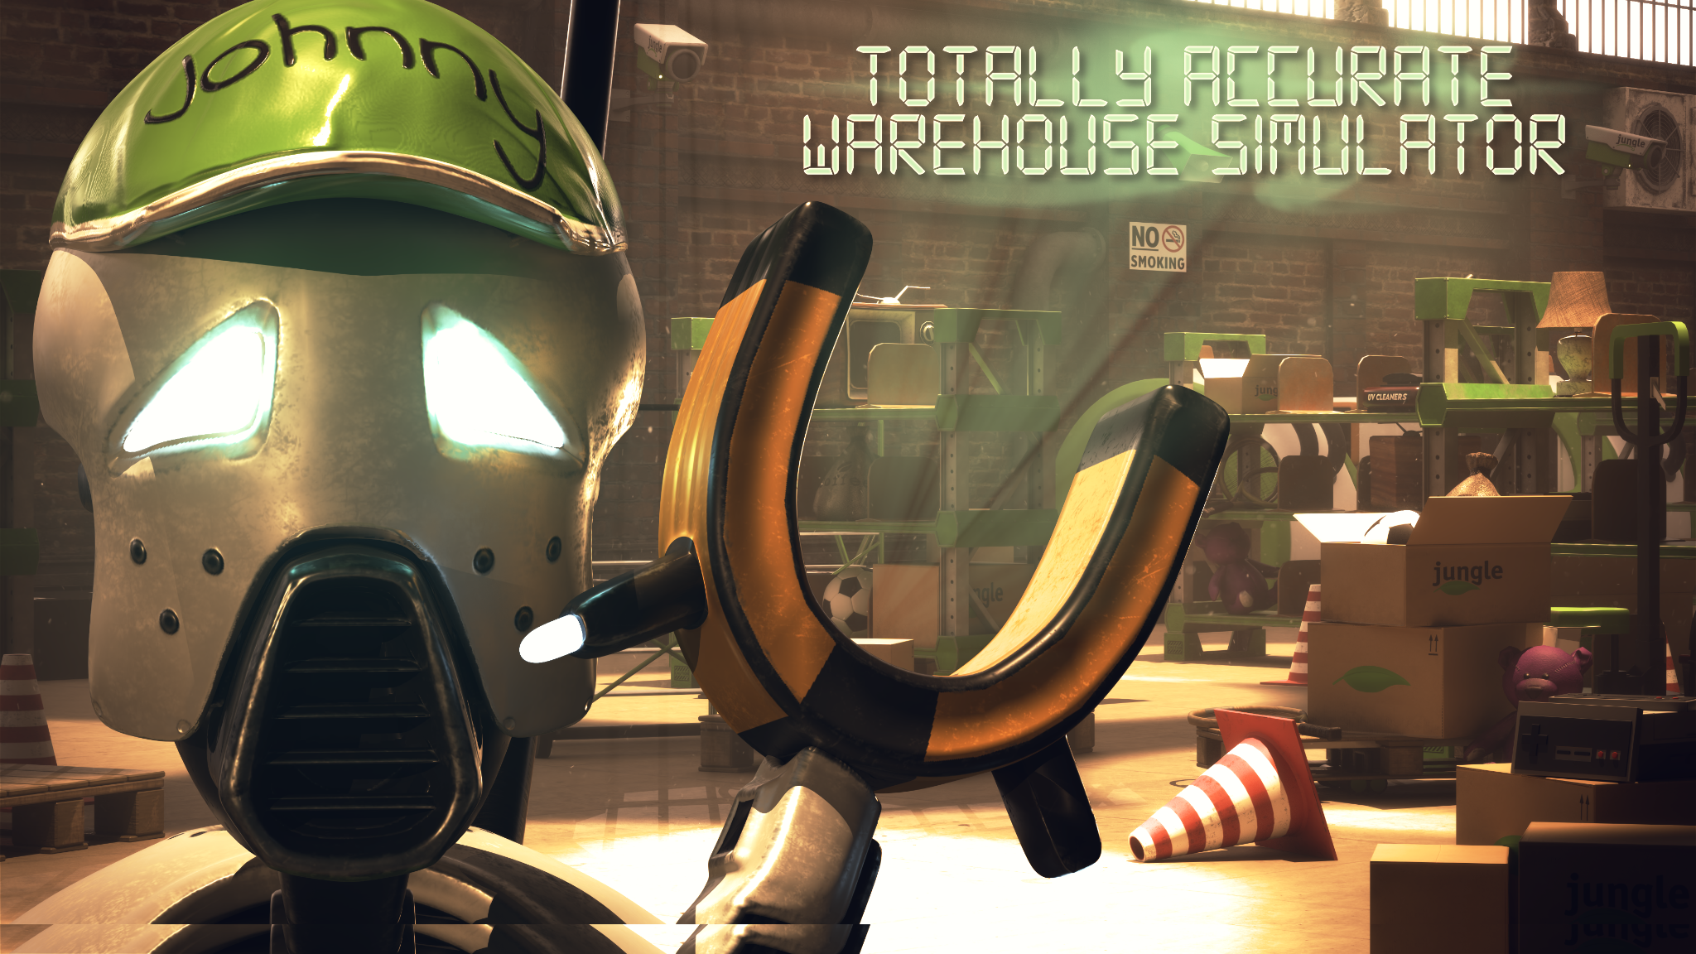
Notes:
Emma

Slide 4

High Concept
Genre:
An action job-simulator.
Target audience:
Skill-honing and achieving player-type.
Game feel:
Experience the joy of repetitive work.
Dehumanizing
Your happiness is our first priority :-(
Notes:
Emma
High Concept:
Title (the title should give an inclination what is to be expected)
Unique selling points (two to three elements which is unique for your game)
Genre (this is no exact science, but check here)
Target audience (describe your player in terms of behaviors, tastes, interests)
Game feel (what do you want your players to feel or experience?)
Narrative (if you have a narrative, tell it as short as you can)

Slide 5
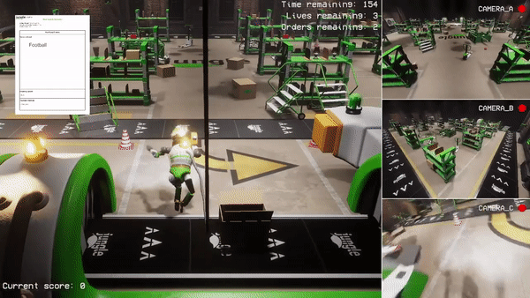
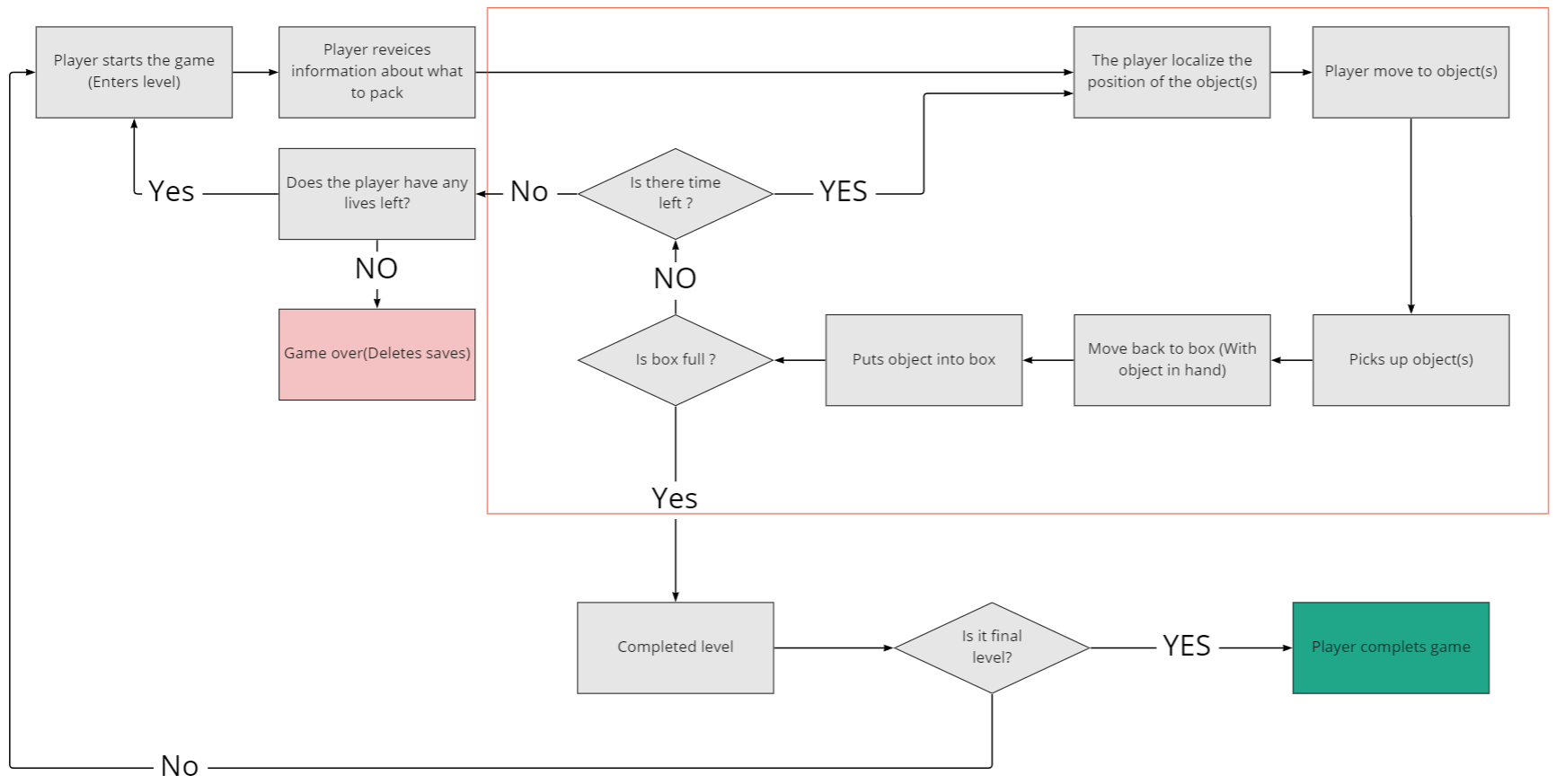
Core Game Loop
In-game core loop
Game loop
Notes:
Frederik
Core Game Loop:
You start the level.
A box arrives with list of items needed to be put in it.
You grab items from the list on the shelves in the warehouse.
You drop items into the box.
When box is full of listed items, you push the button to send the box away
Items on the shelf are randomly spawned from our pool of items

Slide 6
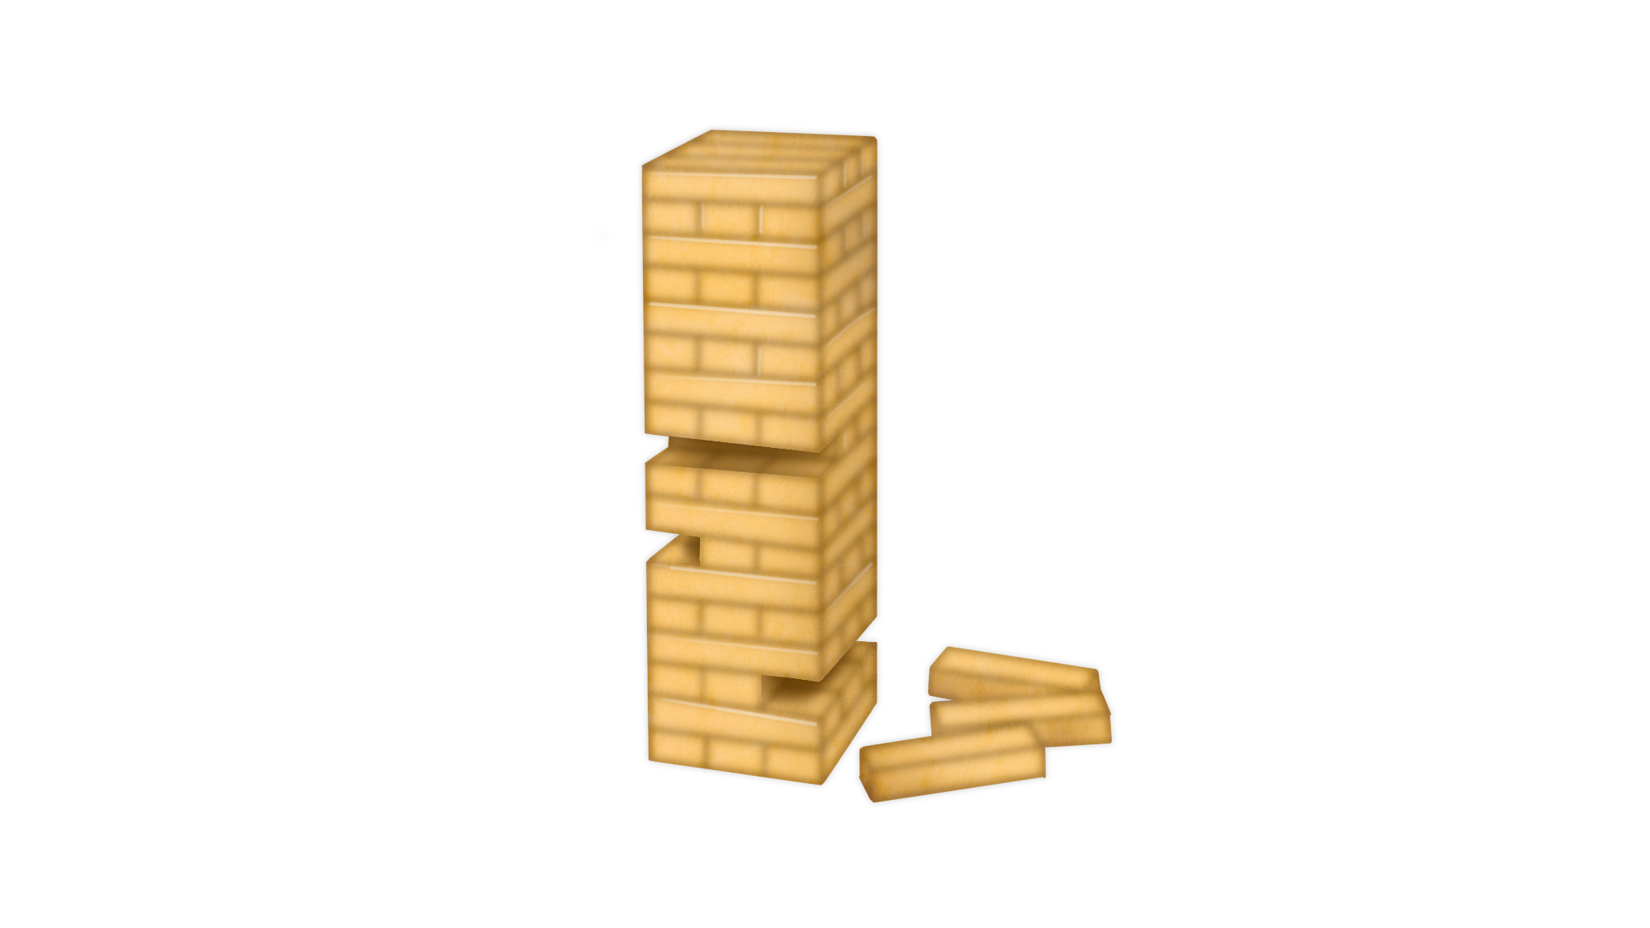
Game Design
Game features:
Wonky and difficult movement.
Physics based environment and interaction.
Procedurally spawned obstacles.
Interactive environment.
Every run is different
Game flow:
Progression:
Increasing difficulty every level
Rewards:
You move on to next level.
Strive to become employee of the month.
Feedback systems:
Audio feedback from boss
Notes:
Frederik
Game Design:
Core game features (controls, cameras, mechanics, etc.)
Game flow (level design, progression, rewards, menus, etc.)
Feedback systems (user interface, use of audio and music, animations, graphical effects, etc.)
(Kim)
Game Design:
Wonky controls
Fixed camera location
Interactions with items on shelves that need to be collected
Conveyor belts as an option for player to use
Game flow:
The levels will physically have the same overall visual layout with the differing elements being which shelves will contain the collectable items, how many of the floor obstacles spawn and the overall time the player is given to complete all the collection tasks on the level
The player progress from one level to the next when all box fillings on the given level have been completed within the allotted time.
Feedback systems:
Any error done by the player will trigger an event in wise for the ingame warehouse boss to react with a voiceline
Animation: When box is completed it visually gets moved along on the smaller conveyor belt and exits.

Slide 7
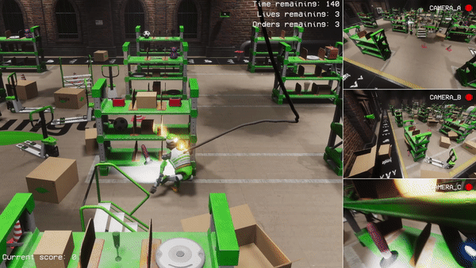
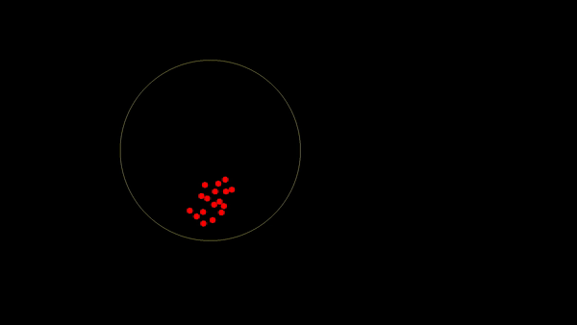
Technical challenge: PCG
Procedural generated obstacles:
Core of the game: movement system
Create obstacles with PCG
Poisson Disk Sampling
Pick a point within spawn area
Place additional point at minimum distance from current point
Remove invalid points
Repeat above until spawn area filled
Spawn assets at points
Notes:
Sutton
If you choose the procedural generated game content challenge:
The game must contain pivotal game elements that are generated on-the-fly.
The game must include a PCG system (procedural content generation system)
capable of generating, altering, and evaluating the experience of the game.
In simple terms, the procedurally generated game content (which may be levels, items,
characters, situations, dressing etc.) conveys variety, novelty, and endless amounts of fun and interest.
You must analyze and describe what the level data is (geometry, textures,
objects, levels, dynamics, atmospheric, effects, etc.) and how you will utilize it (compact, handcrafted,
continuous, runtime, semi coherent, etc.).
Choose algorithms (i.e. Prims algorithm/growing tree, etc.) and data structures based
on your initial analysis and argue for your choice in the
Technical Design Presentation enabling your team to create components for the PCG system.

Slide 8
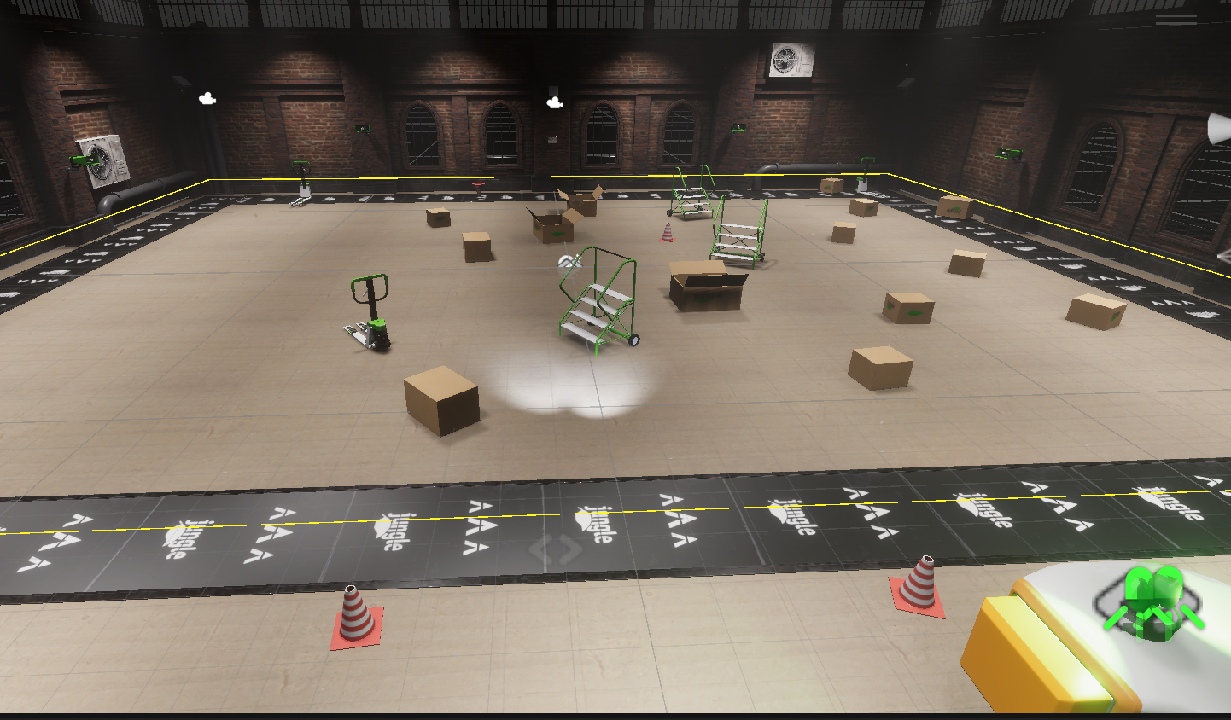
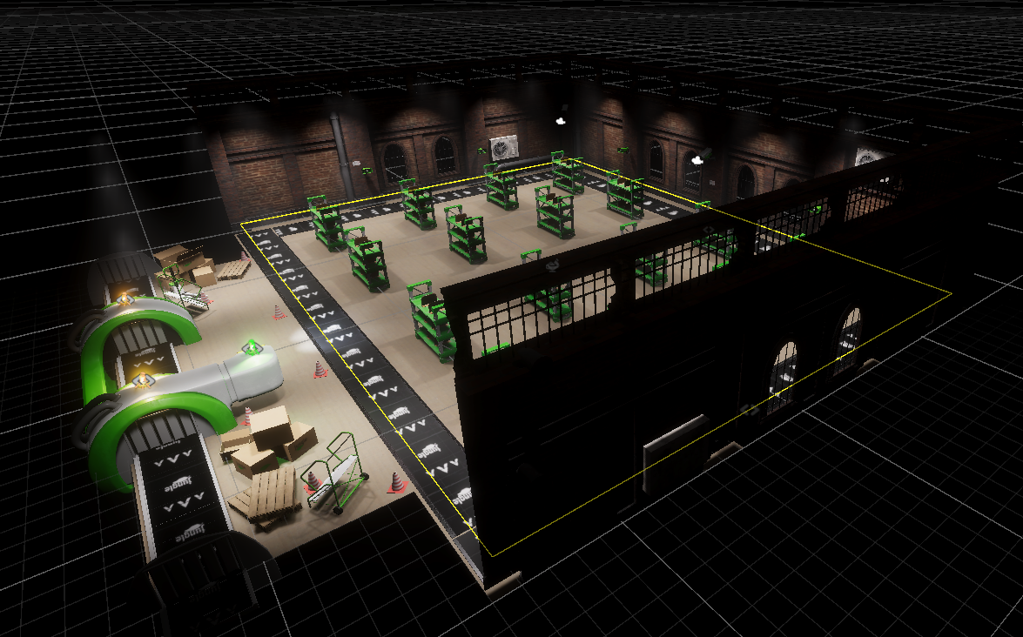
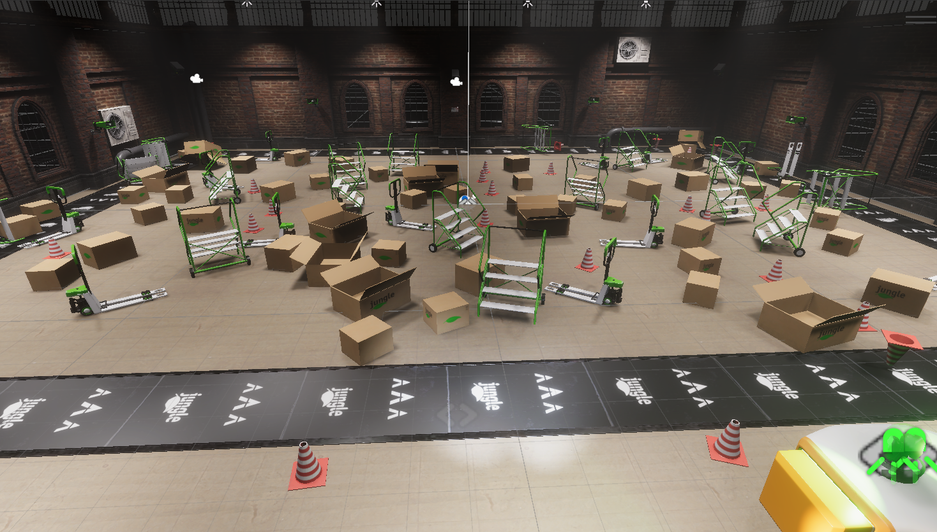
Technical challenge: PCG
Procedural generated obstacles.
Different properties for different assets
Fully configurable
Increase difficulty
Interaction with conveyor belt
Notes:
Sutton
If you choose the procedural generated game content challenge:
The game must contain pivotal game elements that are generated on-the-fly.
The game must include a PCG system (procedural content generation system)
capable of generating, altering, and evaluating the experience of the game.
In simple terms, the procedurally generated game content (which may be levels, items,
characters, situations, dressing etc.) conveys variety, novelty, and endless amounts of fun and interest.
You must analyze and describe what the level data is (geometry, textures,
objects, levels, dynamics, atmospheric, effects, etc.) and how you will utilize it (compact, handcrafted,
continuous, runtime, semi coherent, etc.).
Choose algorithms (i.e. Prims algorithm/growing tree, etc.) and data structures based
on your initial analysis and argue for your choice in the
Technical Design Presentation enabling your team to create components for the PCG system.

Slide 9

Sound design
Notes:
Emilie
Audio Design:
Sketches and soundscapes (sound effects, ambience, music and dialogue, etc.)
Principles for the sonic design in total.

Slide 10
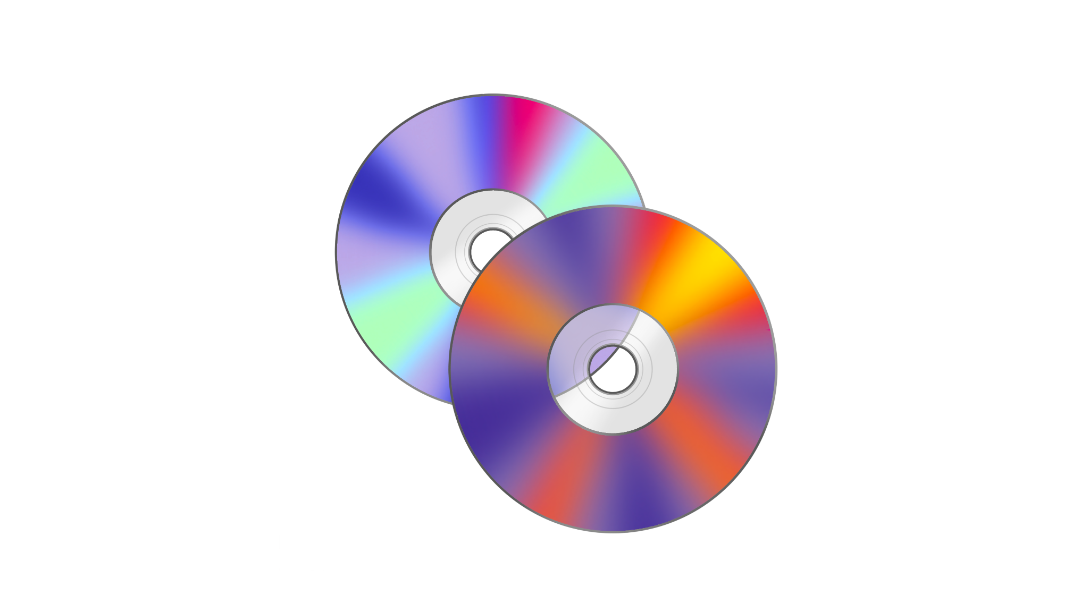
Sound design
Music:
Elevator music (“easy listening bossa nova”).
Contrast to stressful environment.
Audio design:
Rhythmical machines.
Speaker system.
Music + CEO comments.
Friendly facade, passive aggressive.
Several voice lines.
Notes:
Emilie
Audio Design:
Sketches and soundscapes (sound effects, ambience, music and dialogue, etc.)
Principles for the sonic design in total.

Slide 11
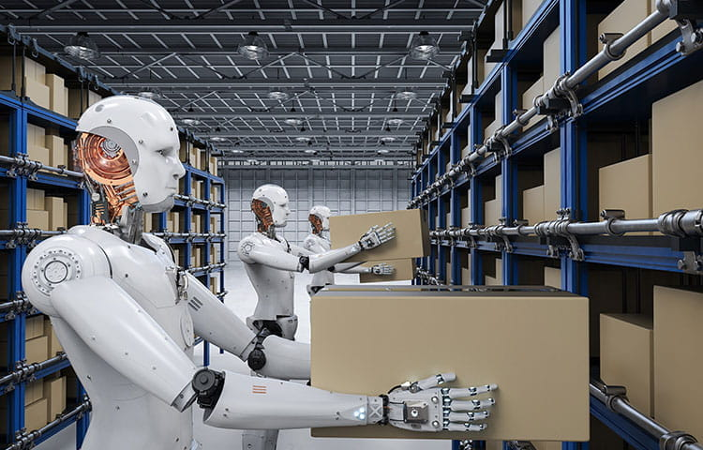

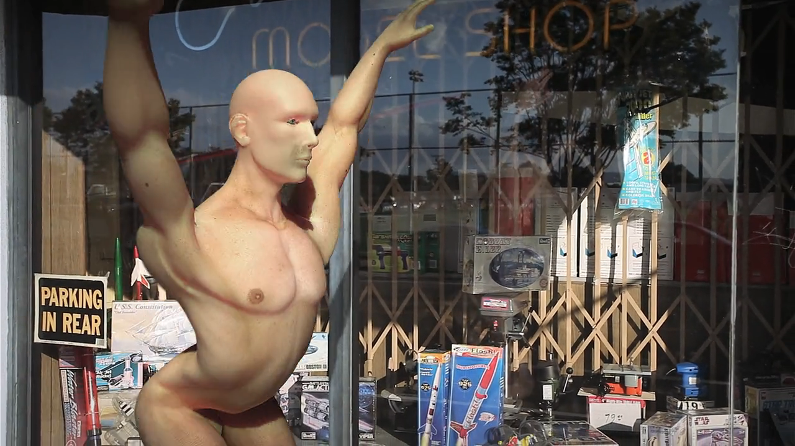
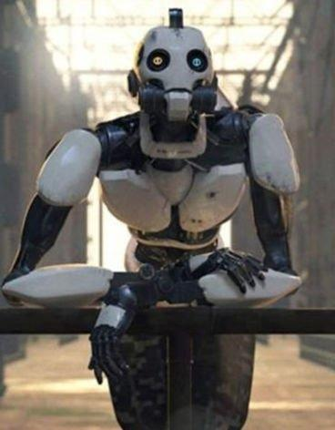
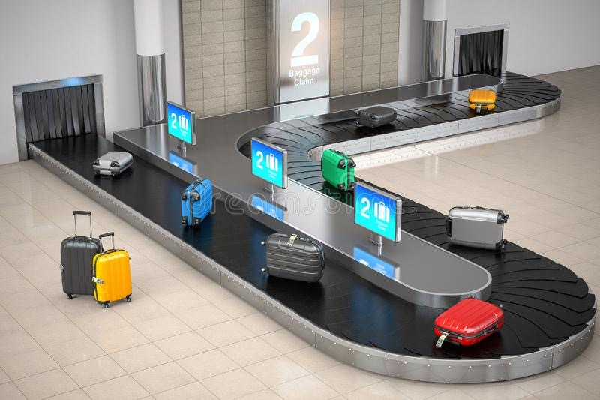
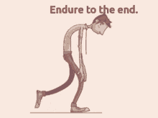
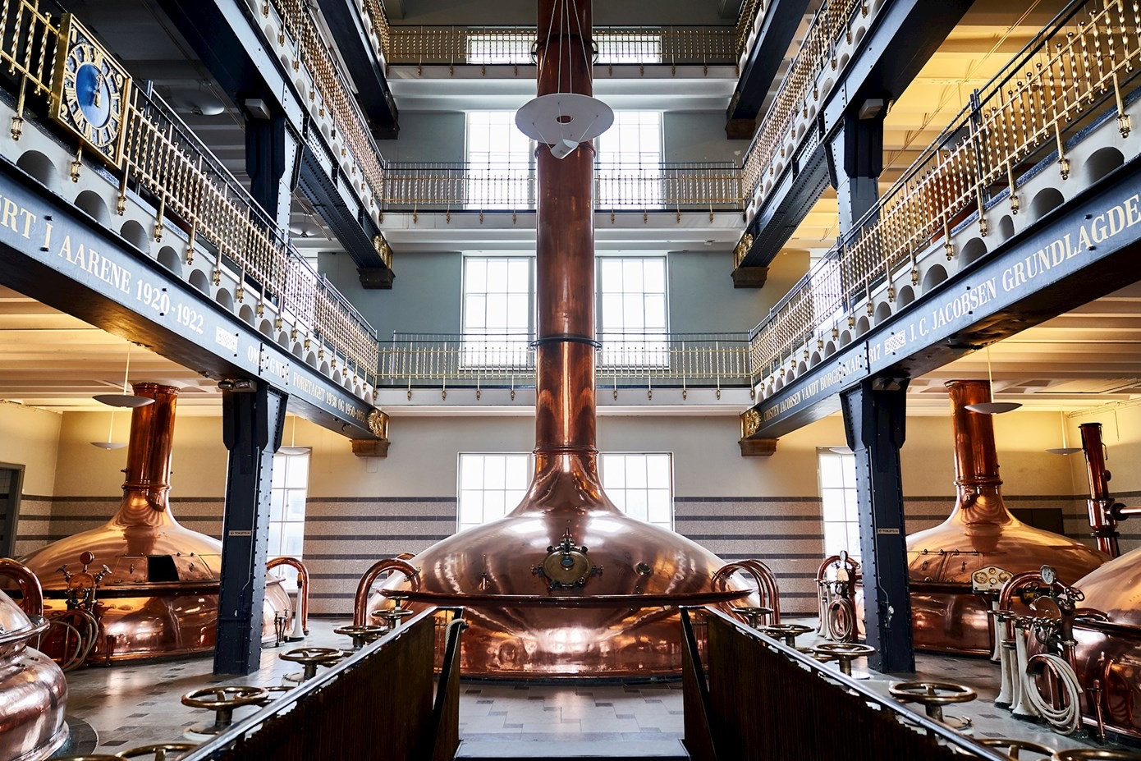

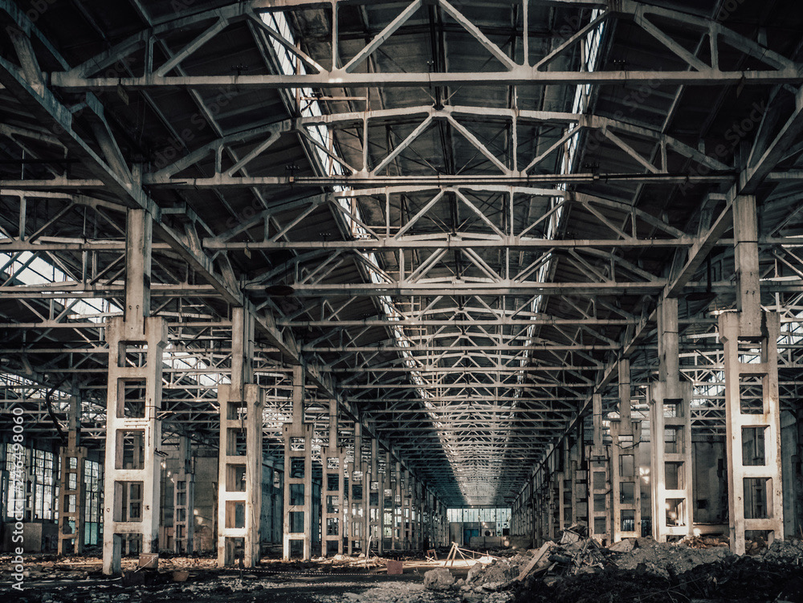

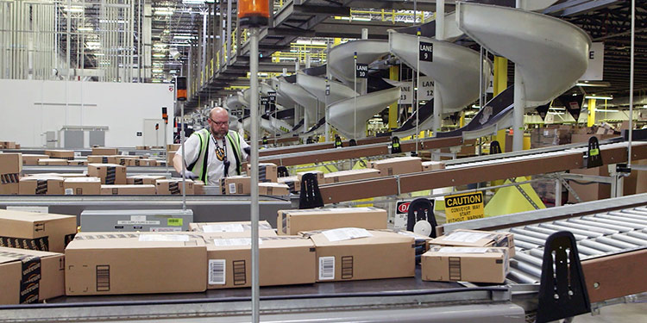
Concept art
Keywords:
Repetitive
Systems
Mundane vs. funny
Routine
Notes:
Fabrizio
Concept art:
Concepts (how will the final look of the game/product incl. UI look like)
Character designs (movement sketches, character sheets, etc.)
Interface design (UI, menu, load screen sketches, particles and effects, etc.)
Key backgrounds/scenes/arenas
Look and feel (settings, lights and shadows, mood boards, color schemes, etc.)

Slide 12
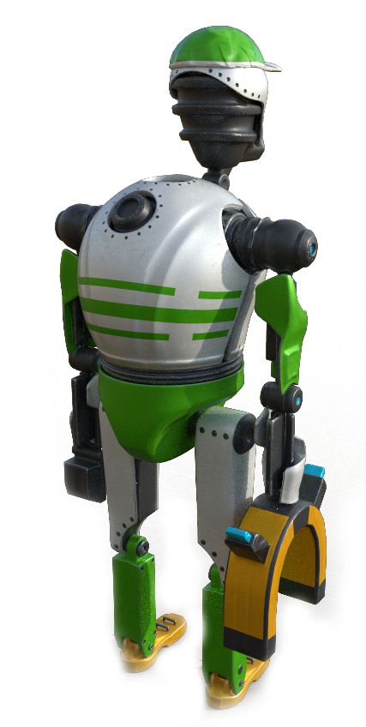
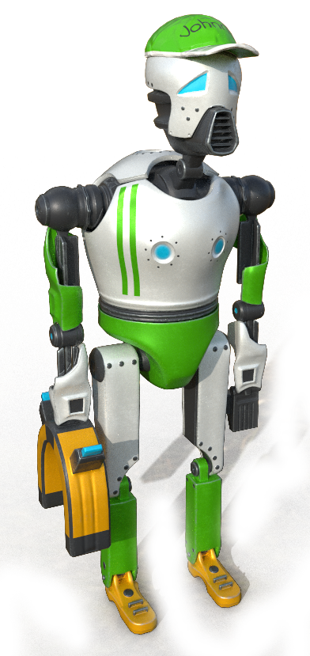
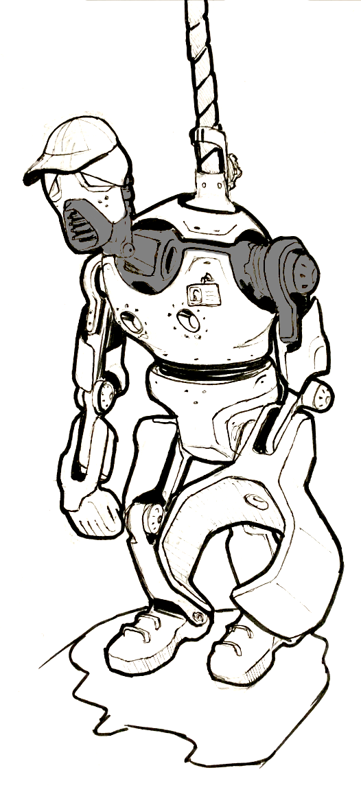
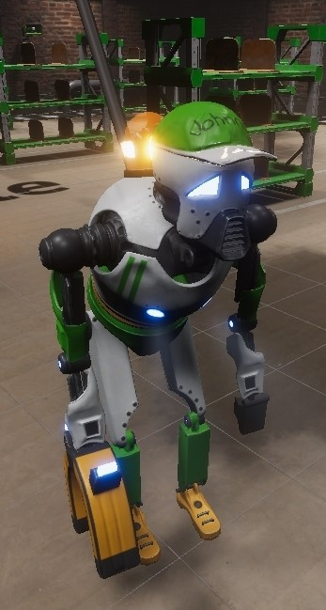
Character Design
Johnny Package (Character)
Humanoid
Melancholic
Sympathetic
Modern but malfunctioning
Notes:
Fabrizio

Slide 13
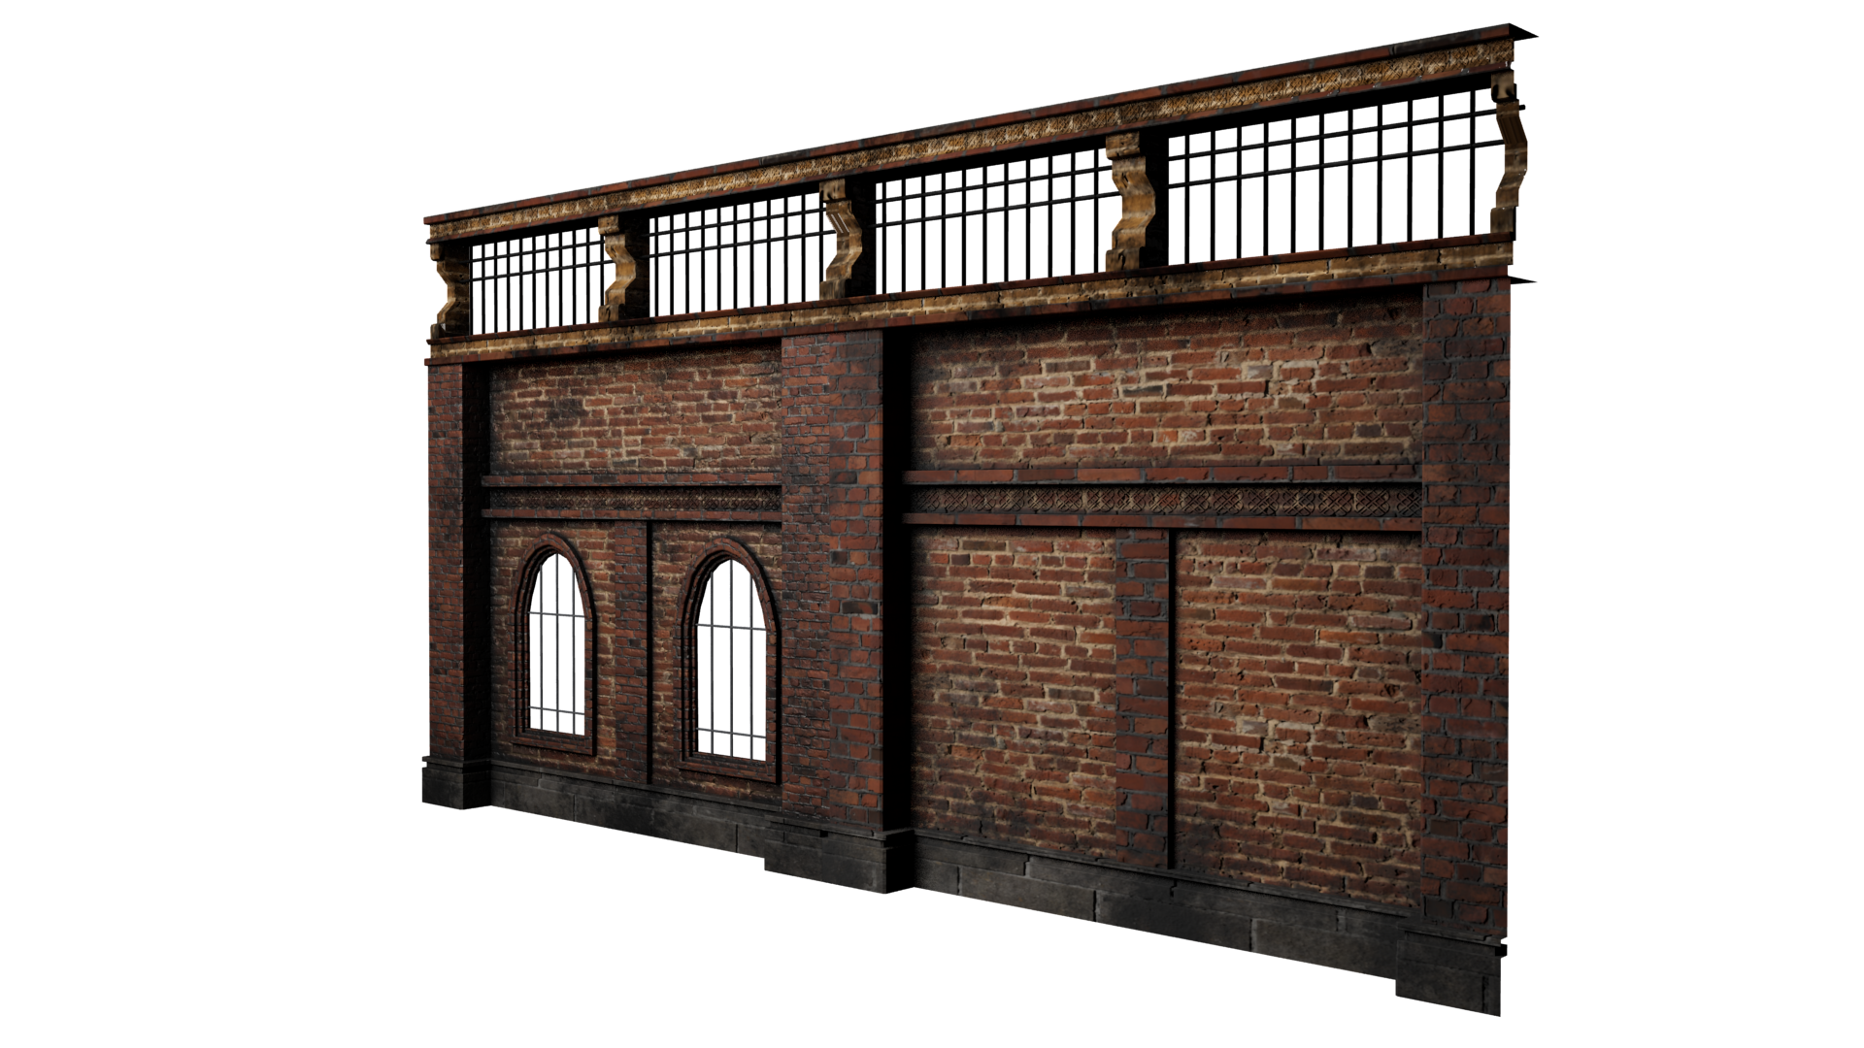
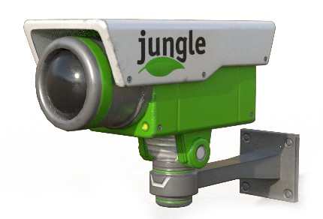
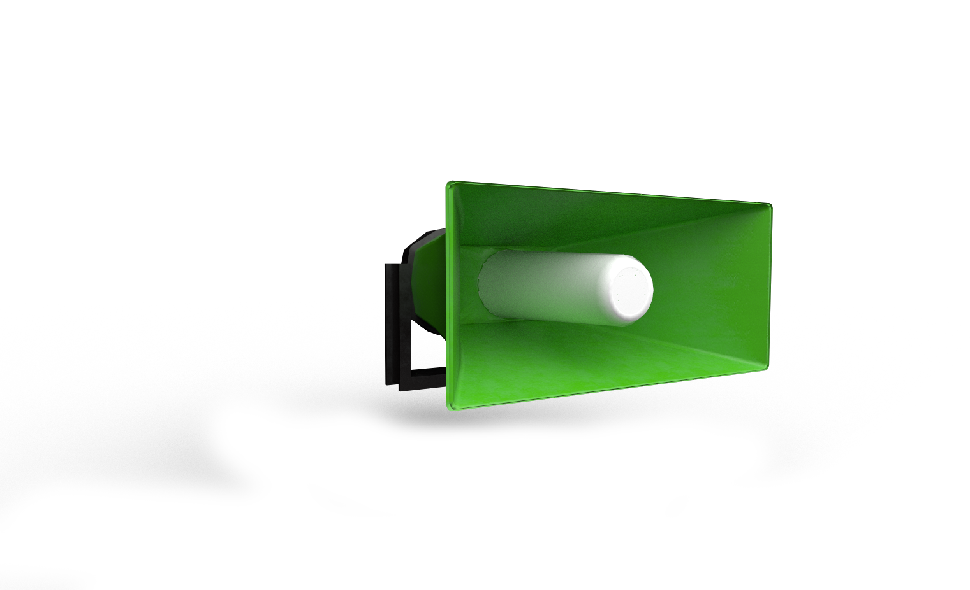
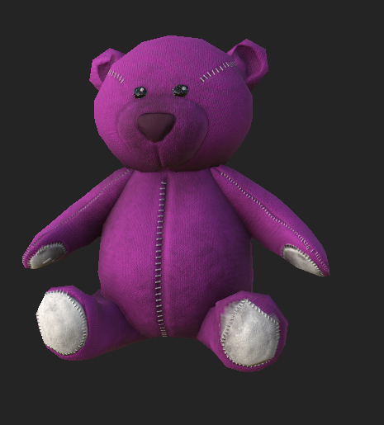

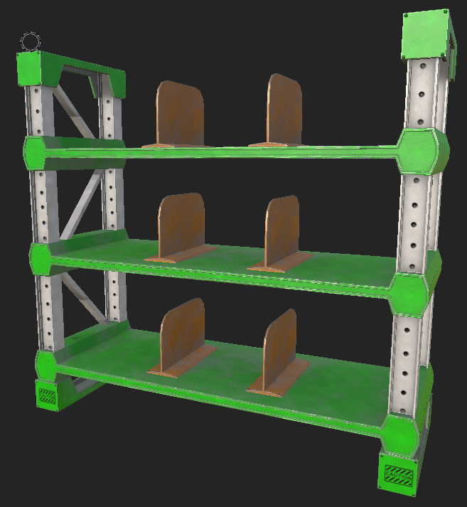

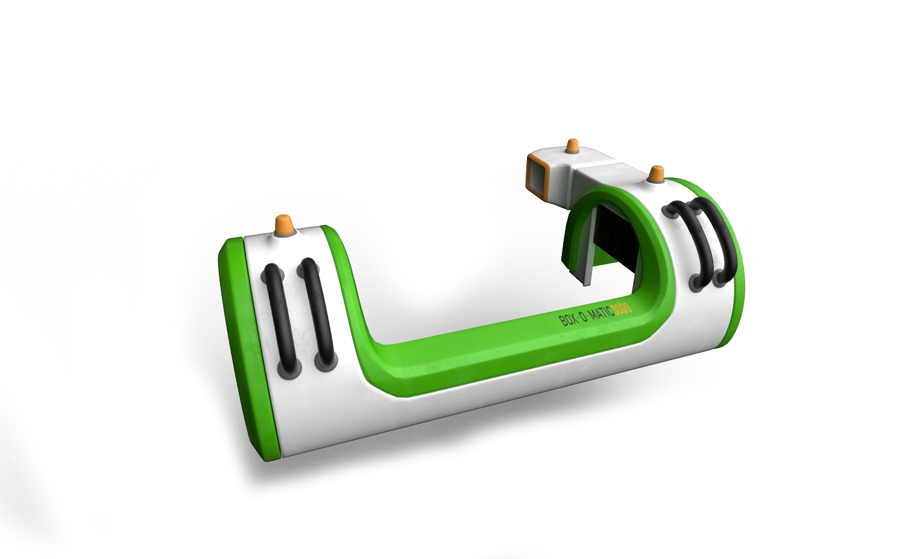
Environmental Design
Assets
Semi realistic.
Realistic texture.
Non realistic shapes.
Modern vs. old.
Notes:
Fabrizio

Slide 14
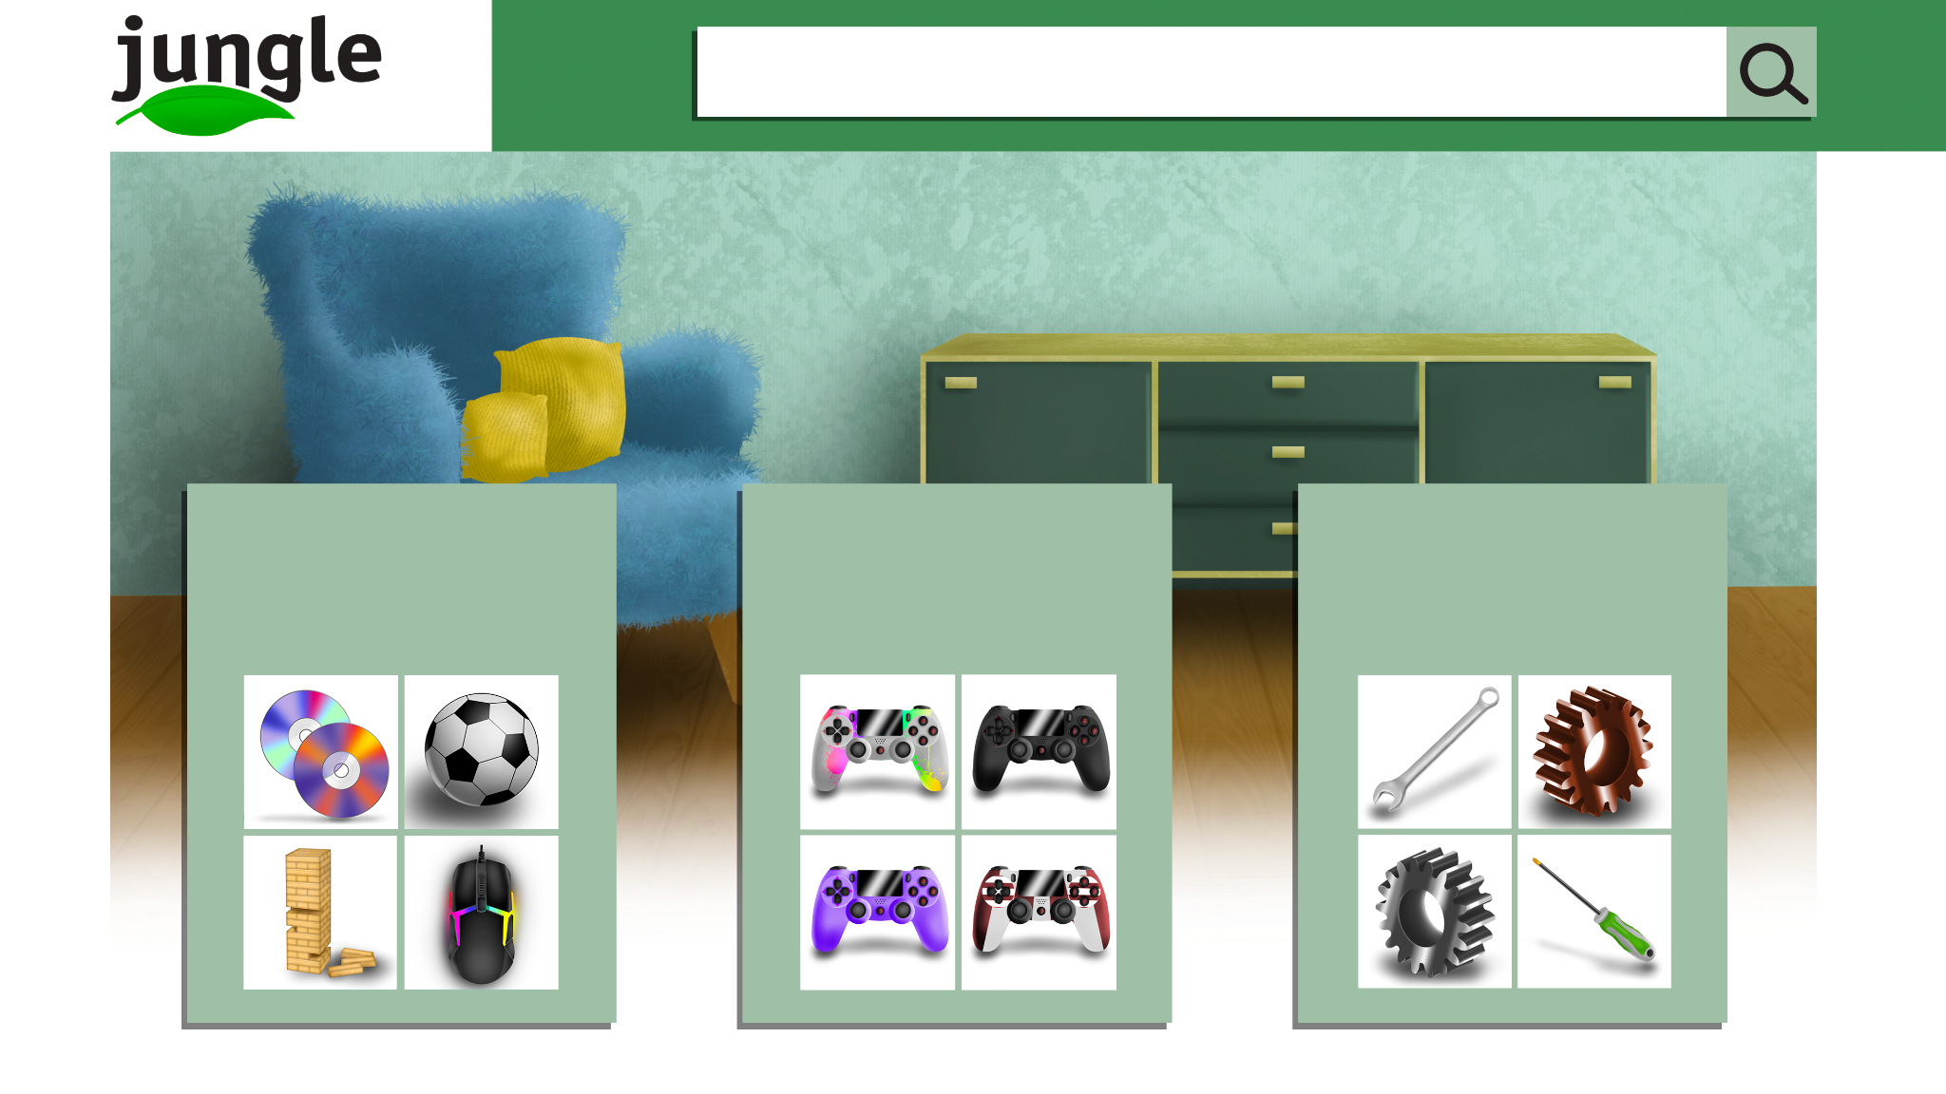
UI Design
Website
Security Cameras
Notes:
Fabrizio

Slide 15

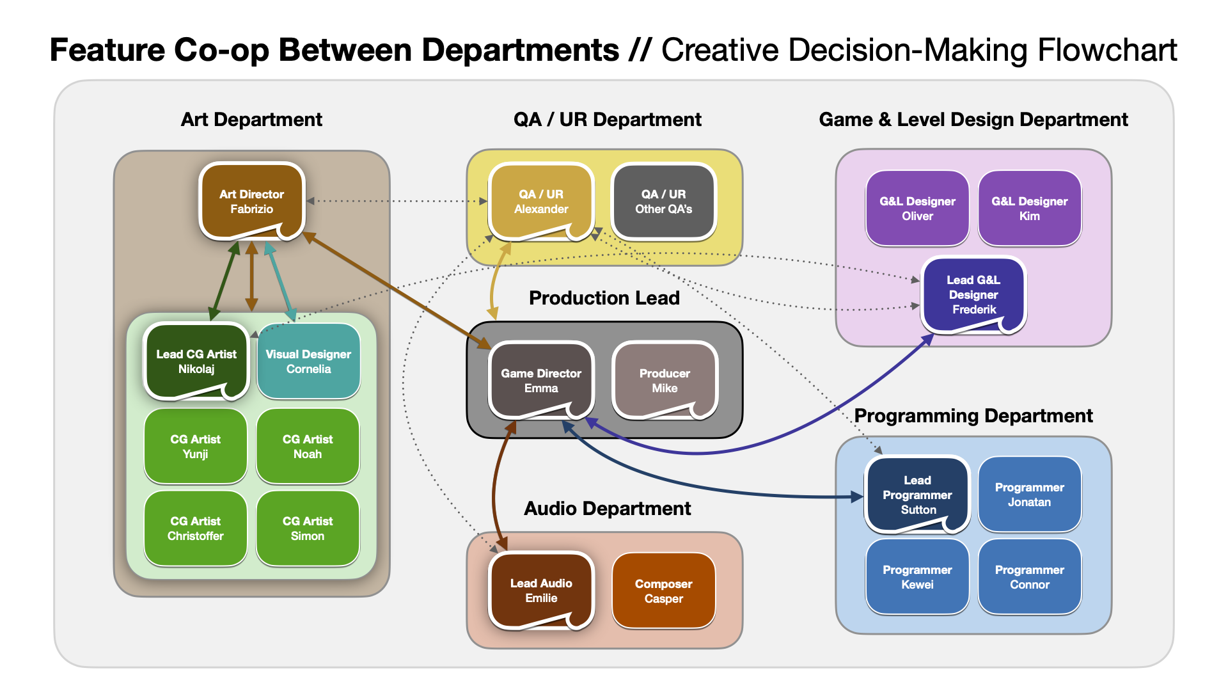
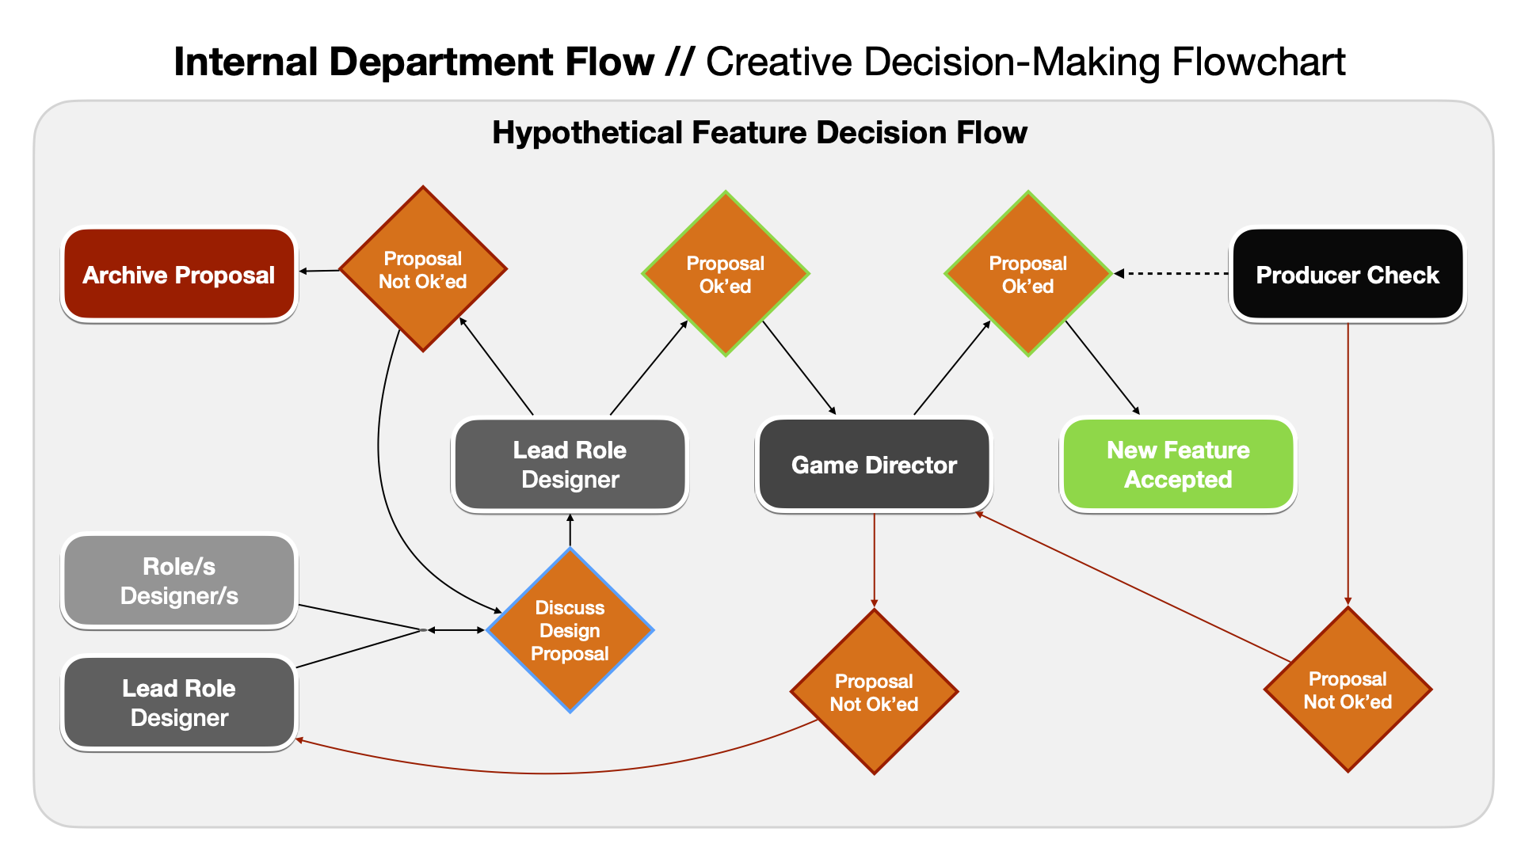
Post Mortem
Workflows:
Communication & Feature Decisions
Availability Indicators
Meeting Rotations
Building upon Feature List
Codecks & Task Updates
Testing:
Delivery of builds
Other:
Copyright Issues
Notes:
Mike

Slide 16

Thank you and don’t forget to visit jungle.com

